Slide 1
Analysis of Customer Service
RITESH REDDY N.P

Slide 2
Business Objective
The analysis aims to leverage data-driven approaches to optimize customer service processes, enhance customer experience, and drive overall business growth. By examining historical customer service data, the project seeks to identify patterns, trends, and opportunities for improvement, ultimately leading to enhanced customer loyalty and increased operational efficiency.

Slide 3
Project Goals
Customer Sentiment Analysis.
Root Cause Analysis.
Service Response Time Analysis.
Customer Segmentation.
Trends and Patterns Identification.

Slide 4
PROJECT STRUCTURE
Business awareness.
Organizing data.
Calculating the required fields that are important for the analysis.
Visual representation.
Gathering all the visual representations in one final sheet(Dashboard).
Making them interactive and impacting on the clients.

Slide 5
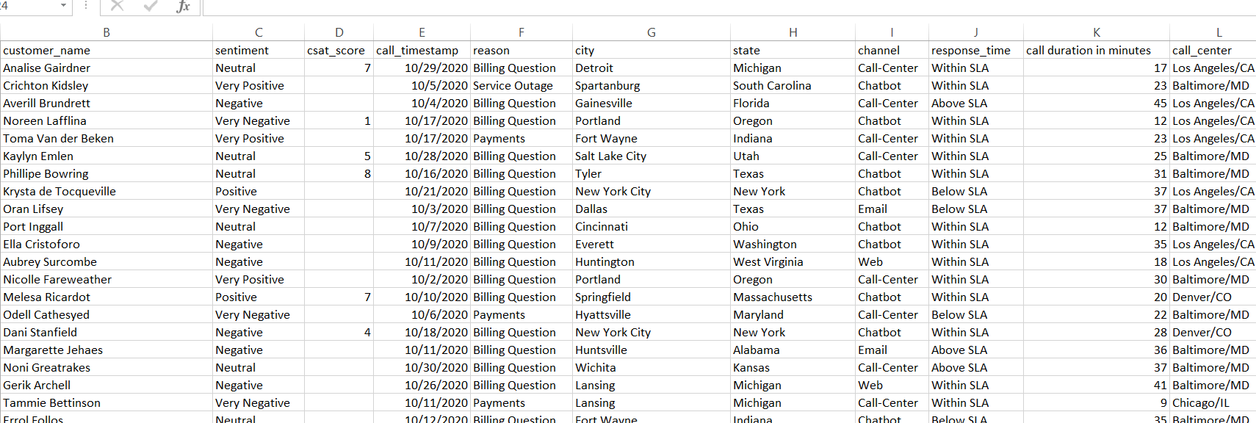
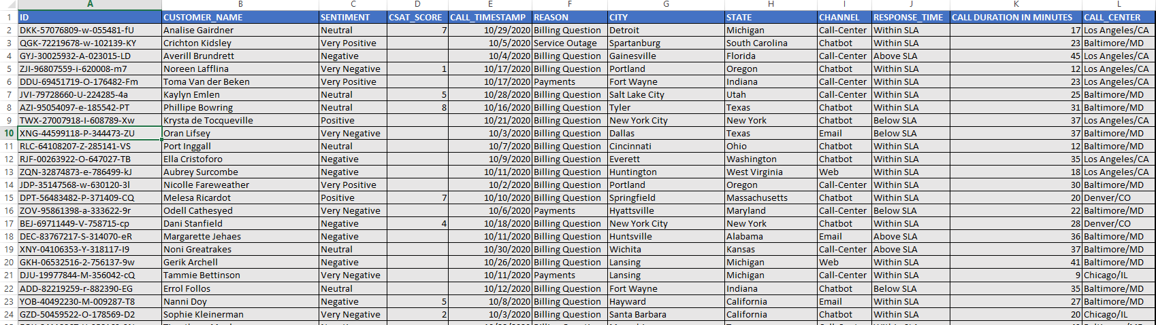
Organizing data
Data that is being provided might have multiple error or might be missing few important key details , so we should make sure all that are been sorted out and be able to understand every bit of a data to make a good analyses.
Can also design accordingly.

Slide 6
Visual representation
Every data sets that needs to be compared can be done using pivot tables and pivot chart for data visualization purpose.
My six comparisons for data visualization are as follows:
SENTIMENT ANALYSIS.
REASON ANALYSIS.
CHANNEL ANALYSIS.
SLA ANALYSIS.
CALL CENTER ANALYSIS.
CSAT SCORE ANALYSIS.

Slide 7
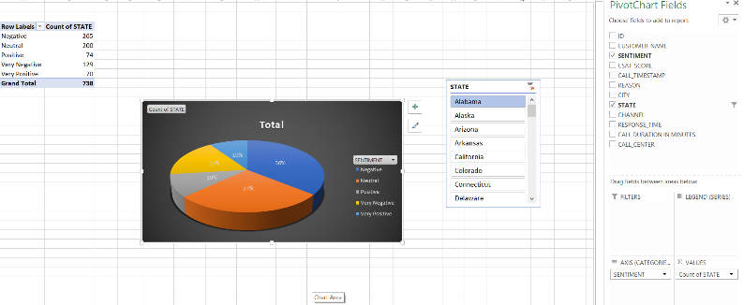
SENTIMENT ANALYSIS
I have used pie chart (Pivot chart)for sentiment analysis.
Where the data of sentiments is given in the rows area and the states data is given in the values area in the pivot table.
Now we can get the overall sentiments on a whole and also by using the pivot slicer we can visually look at the state wise sentiments data. And trough slicer it is interactive too.

Slide 8
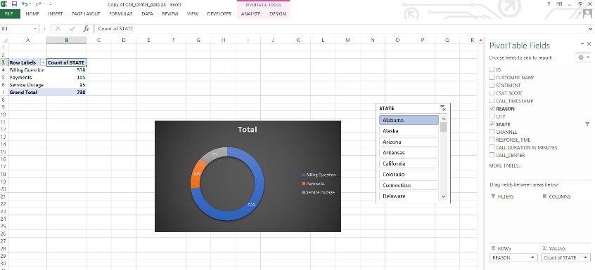
REASON ANALYSIS
I have used doughnut chart to show the reason analysis.
Where the data of reasons is given in the rows area and the states data is given in the values area in pivot table.
Now we can get the overall reasons on a whole and also by using the pivot slicer we can visually look into the state wise reasons data.

Slide 9
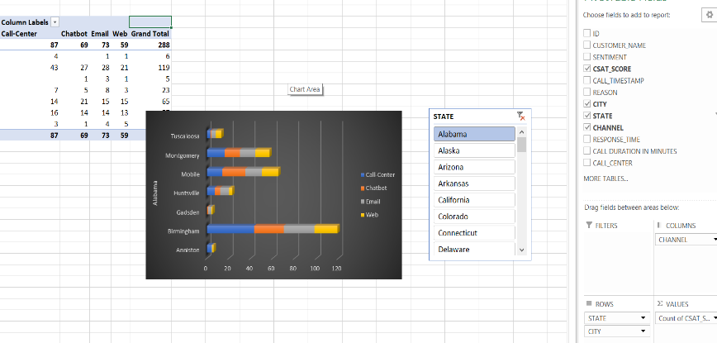
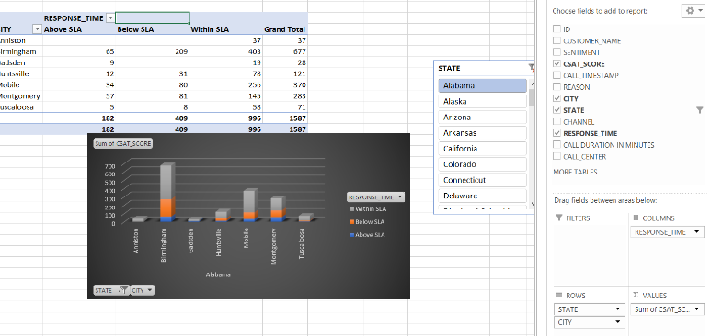
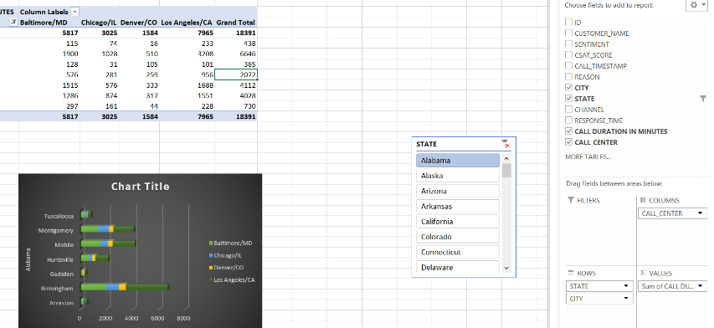
CHANNEL ANALYSIS,SLA ANALYSIS,CALL CENTER ANALYSIS
These analysis are done using column chart and bar chart.
They delivery multiple information in one chart and these charts.
These chart better be used with the slicer where these charts provide the information state wise.

Slide 10
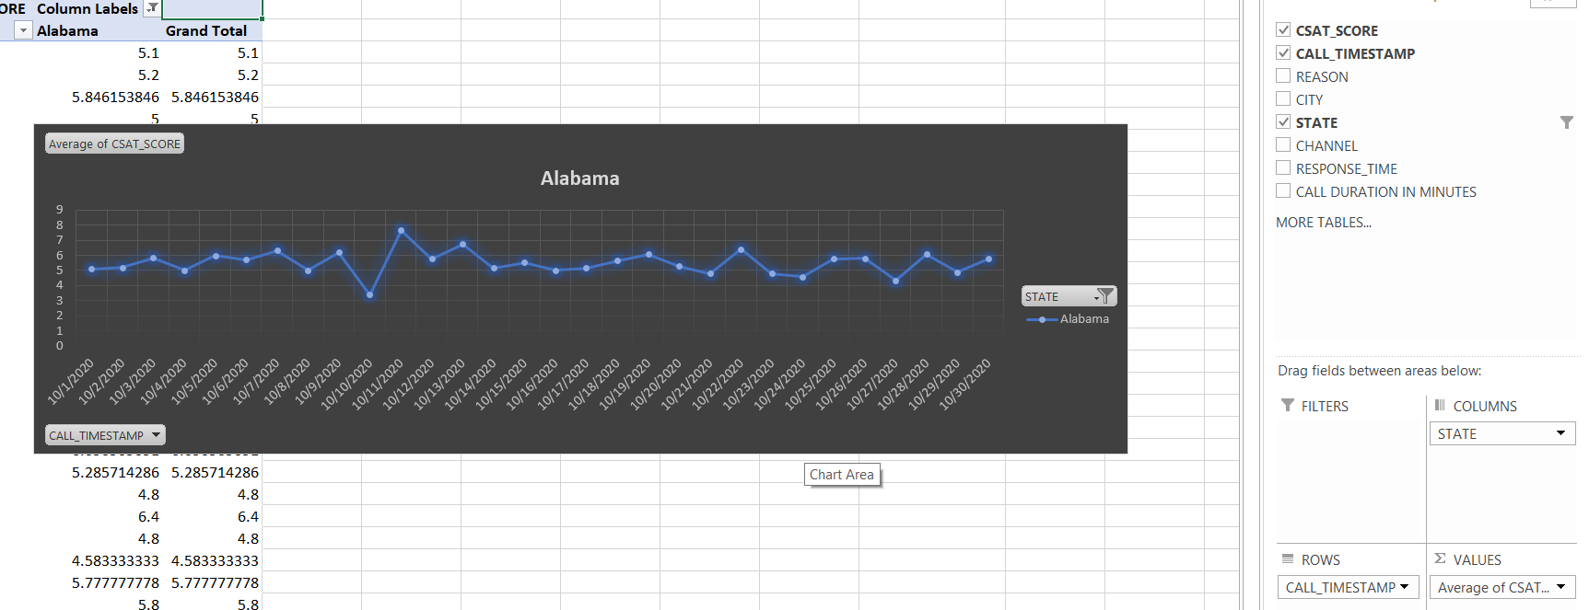
CSAT SCORE ANALYSIS
For customer satisfaction score I have used line chart.
The data this provides is the customers average rating on scale of 1 – 10 state wise through out the dates given.

Slide 11
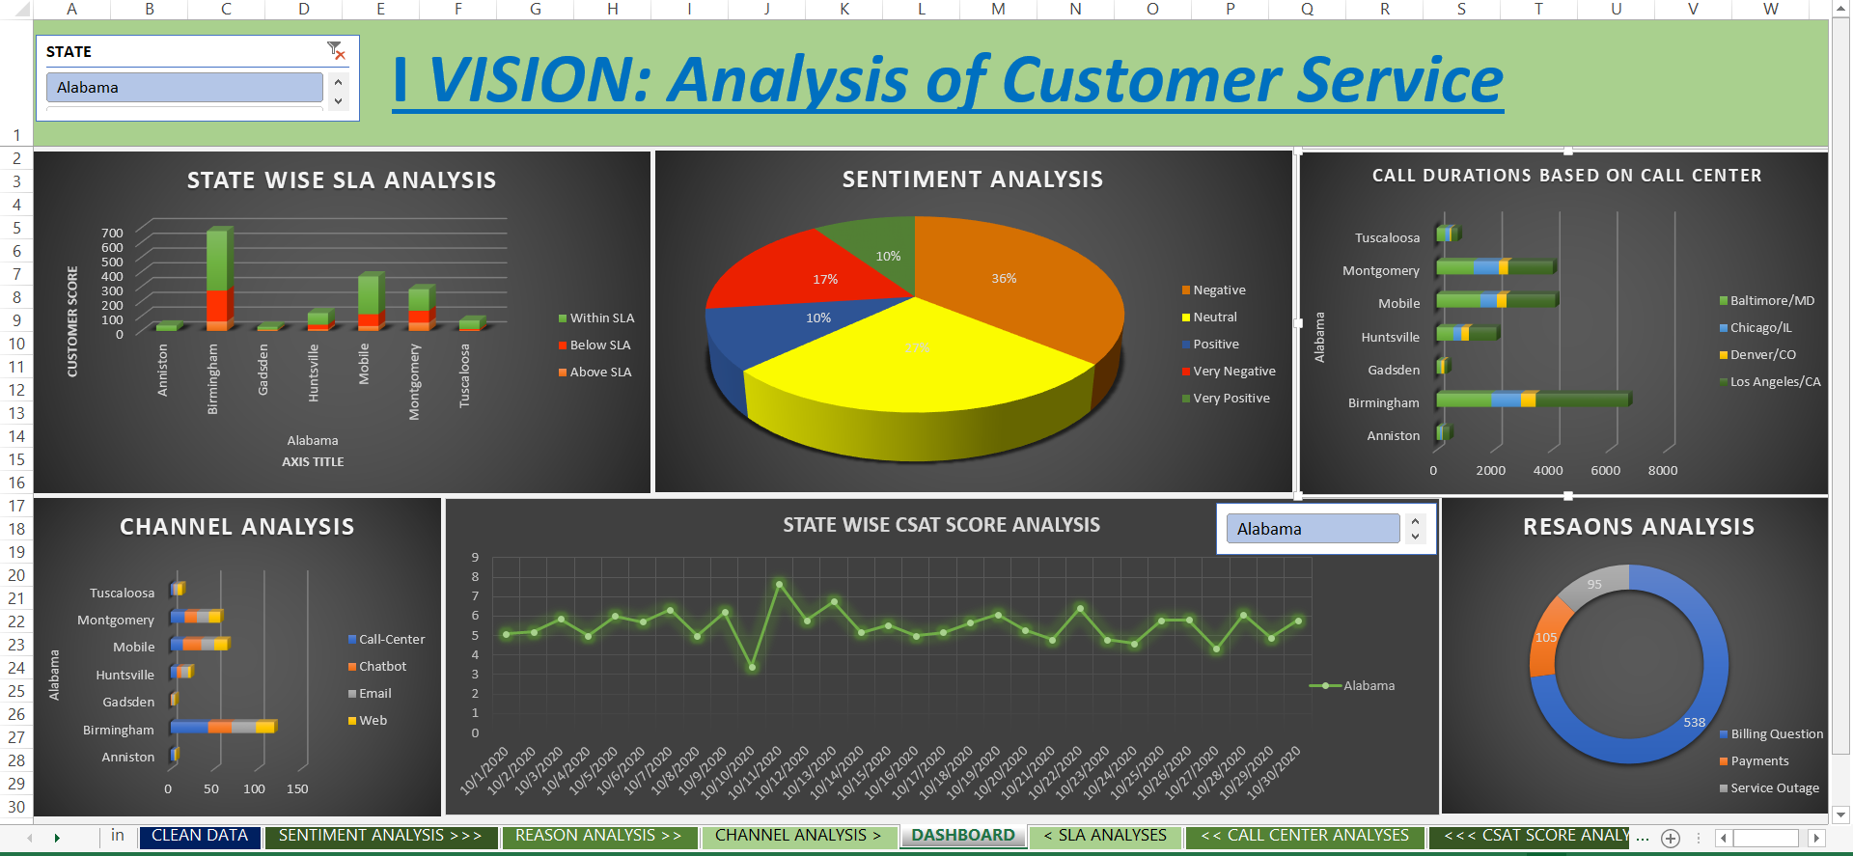
FINAL DASHBOARD
Every chart that has been created can be put together for the final dashboard and could make it interactive so that clients have better visual understanding

Slide 12
THANK YOU

